Slide 1
Web-Security Basics
Thomas Biege <thomas@suse.de>

Slide 2
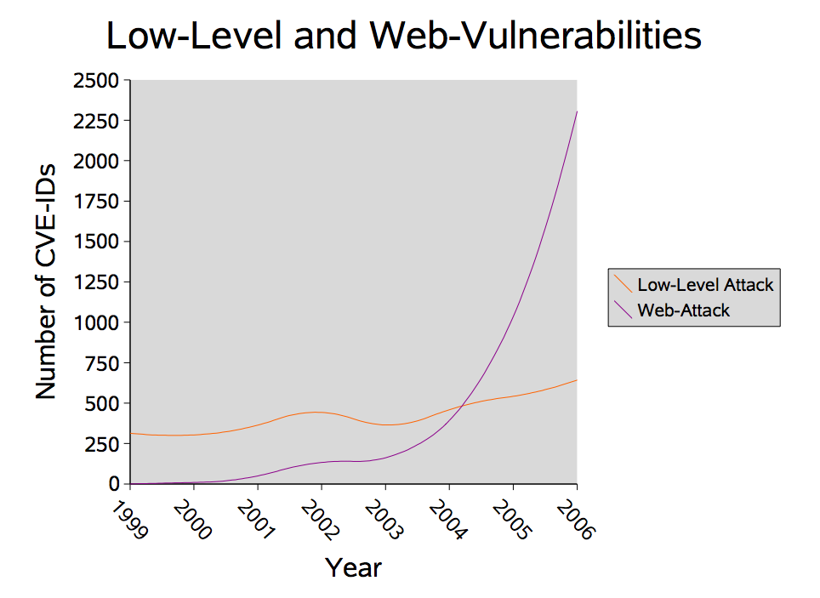

Slide 3
What will you learn here?
Overview of Common Web-Security Problems
Authentication in the Web
Ways to protect your Code

Slide 4
Who and What is not trustworthy?
Input, the Source of all Evil :-o
Header-Fields can be arbitrarily set
JavaScript-Code is running on the Client-Machine and is not under Your Control
Cookies, hidden Fields, etc.
Output from Backend-Servers

Slide 5
Input/Output
LDAP/SQL-Injection
Command-Execution (Perl, Shell, PHP, ...)
Cross-Site Scripting (XSS)
Cross-Site Request Forgery (CSRF)

Slide 6
The Basic Problems
Switching of Parser-Context
  Blacklists for Output: incomplete, easy to use
  Whitelist for Input: more secure, hard to define?
check Data-Type, -Length and -Range
use Naming-Conventions to spot tainted Data more easily (like prefix: tainted_ and secure_)

Slide 7
Stopping SQL-Injections
use Prepared Statements
Escaping to neutralize SQL-Statements that trigger a Change of the Parser-Context (Data Command)
Some Languages (like PHP) and Libraries provide Functions for it:
  mysql_escape_string()
  mysql_real_escape_string()

Slide 8
Stopping Shell-Injections
avoid using popen(), system(), $(), ``, passthru(), Perl’s open(), glob(), <>, etc.
remove “-” and “--” from the Beginning of every String you pass to Shell-Commands
Escaping, by using:
  escapeshellarg()
  escapeshellcmd()

Slide 9
Stopping XSS
Do not allow HTML/JavaScript/... in:
  Everything that can be displayed to other Users
  direct Input to a Forum
  Filenames
  URLs
Escaping, by using:
  htmlentities()
  htmlspecialchars()

Slide 10
Stopping Directory-Traversal and Friends
work in a “Chroot-Environment” (open_basedir)
use random Filenames locally (for Uploads)
or completely avoid the Filesystem and put File-Contents in a Database
remove “/” and “\” from the String’s Beginning
remove “../” and “..\” from the String

Slide 11
Authentication Methods
Basic Authentication
Digest Authentication
Application-based Authentication
  with Cookies
  etc.
Without SSL you are lost!

Slide 12
Basic Auth
very simple and insecure
can be configured by Server and/or Application (PHP: header())
Credentials are only base64-encoded
vulnerable to Replay-Attacks
vulnerable to Man-in-the-Middle-Attacks
use it with SSL only

Slide 13
Digest Auth
Password is NOT sent over the Wire
NOT vulnerable to Replay-Attacks (only in a limited Time-Window ;-) )
Message-Integrity only optional
can be configured by Server and Application (PHP: header())
Message-Content is not encrypted (use SSL)
does NOT protect against Man-in-the-Middle and Downgrading-Attacks

Slide 14
App-based Auth
ask User for Credentials using a Form
HTTP is state-less
Session-Management with Cookies, Fat-URLs, etc.

Slide 15
secure Session-Handling
Cookie as Container for Authentication-Token
avoid putting Auth-Token in URL, it can leak via the Referer-Header (+ Session-Fixiation Attacks)
HTTPonly- and Secure-Flag to avoid leaking
non-persistent Cookie
Cookie Lifetime is NOT mandatory!
re-authenticate before handling security-relavant Client-Requests (like changing Password)

Slide 16
secure Session-Handling
Session-ID has to be cryptographically random
remove/re-new Session-ID if/on:
  Logout
  Session-Context changes (Session-Fixiation)
  Expiration of Lifetime
  Referer-Header shows Redirect from off-site (XSS)
  User-Agent changes (forgeable) (Cookie stolen)
  Client-IP changes (unreliable: Proxy) (Cookie stolen)

Slide 17
secure Session-Handling
crypto. MAC to generate/protect Auth-Token:
  Server-Secret as Key
  MAC(username$session-id$timestamp, Key)
  Separator ($) should not be Part of Input (filter)
  Timestamp is the same as Cookie Exp.-Time
  Timestamp can also be in a Database
  use User-ID to lookup Authorisation-Settings, Session-ID, and Timestamp if needed

Slide 18
Information-Leakage
Forms received over HTTPS, POST over HTTP
verbose Error-Messages and Comments in JS-Code
Source-Code Files not handled by Web-Server
Filename-Suffixes and well-known Files, like:
  *.bak, *.*~, *.inc, etc.
  WS_FTP, citydesk.html
  etc.

Slide 19
I want more Details!
more Presentations:
  Sanjay Gupta: Security Consideration for Web-Applications
  Jason Sabin: XSS, Cross Site Scripting, and why would you do that?
  etc.
Have a Look at:
https://wiki.innerweb.novell.com/index.php/Web_security

